Slide 1
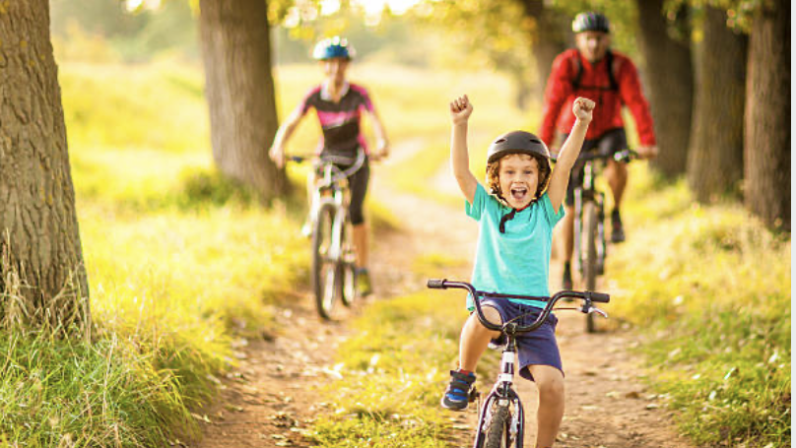
Biking for Kids
(and that means for everyone)

Slide 2
Why Do you care?

Slide 3
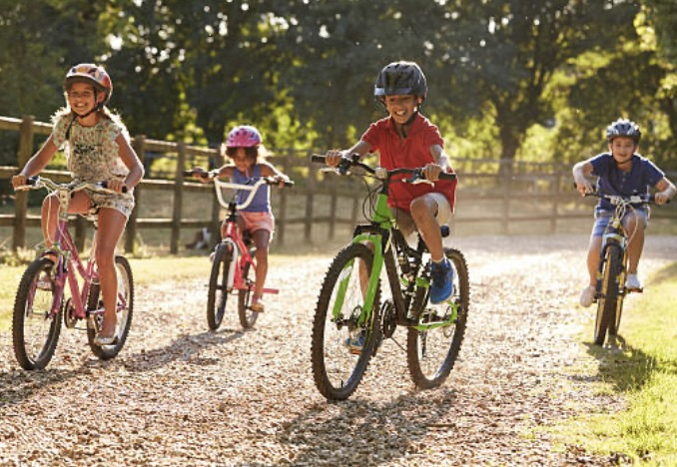
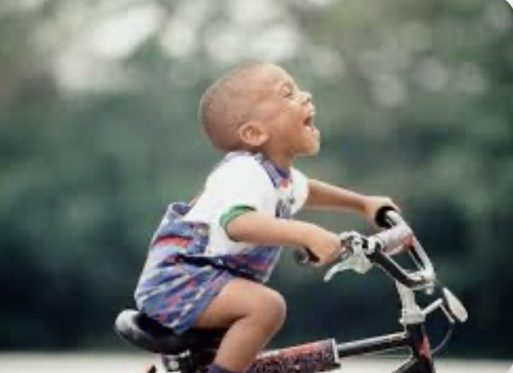
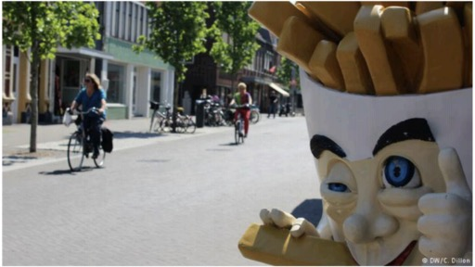
Why do you care?
Independence
FUN!
Healthy people!
Healthy Planet

Slide 4
What is it like now for you to bike now from your home?

Slide 5
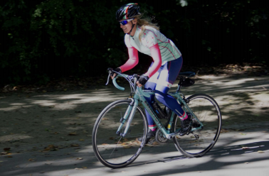
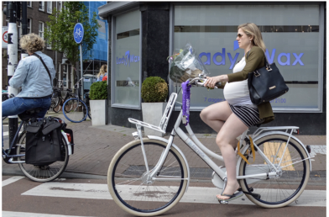
How Do We Get Lots of People Biking? (instead of driving or being driven?)
Not Just this
Mostly This

Slide 6
How Do We Get Lots of People Biking?

Slide 7
But This is Who We (mostly) Design For

Slide 8
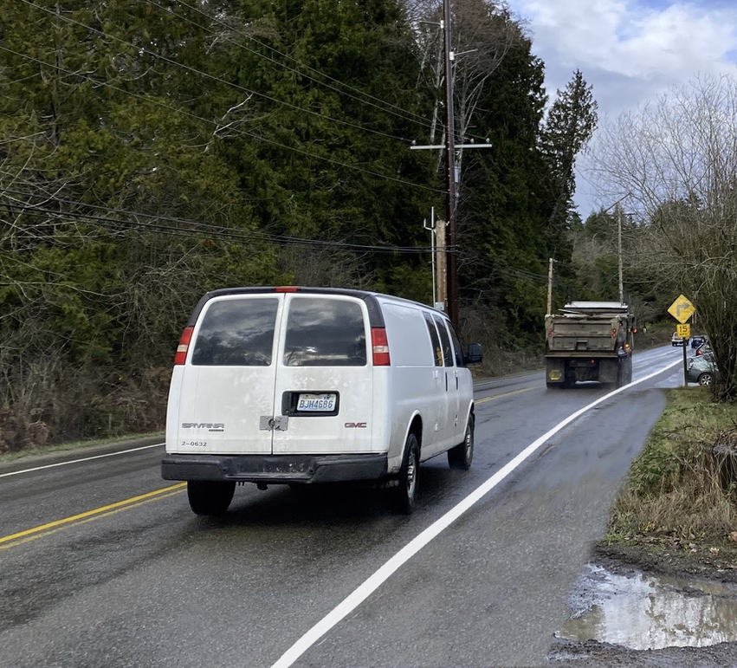
Would you like to bike here?
This is what Eagle Harbor would look like with a 5’ shoulder added.
(Vehicular Cyclists are trying to get this)

Slide 9
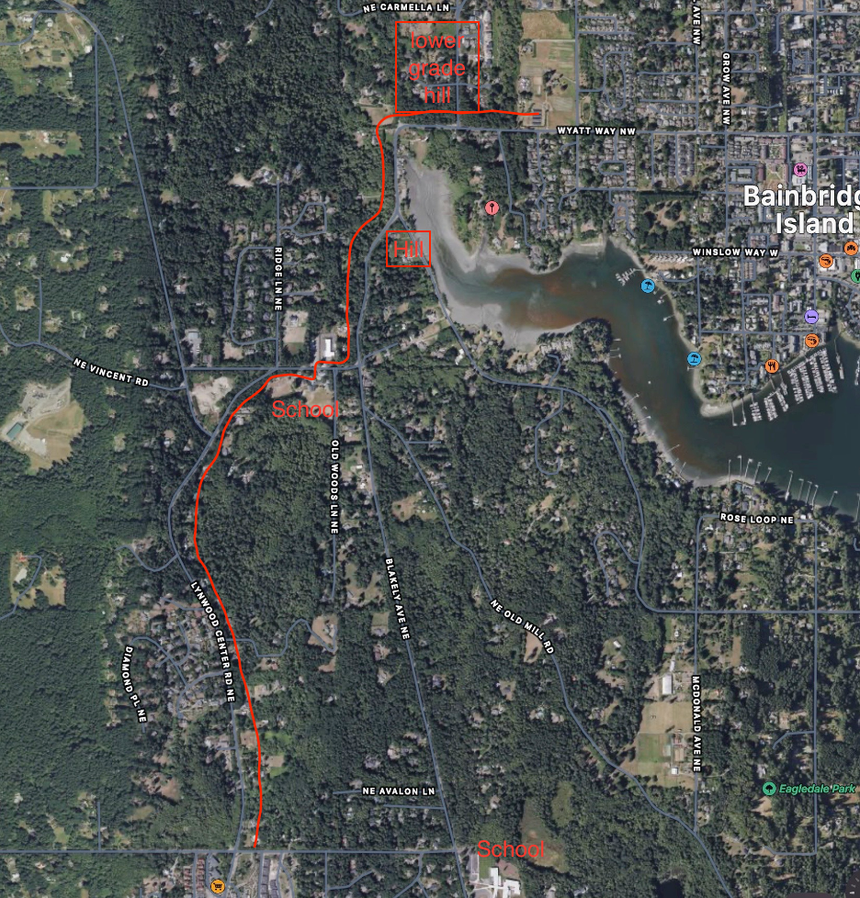
Big Bike Project on Bainbridge Island Happening now: Eagle Harbor
All kids from the south have to take this route to get to most schools
Busiest and fastest street on the island, other than 305
Will be the route all the way to Lynwood eventually

Slide 10
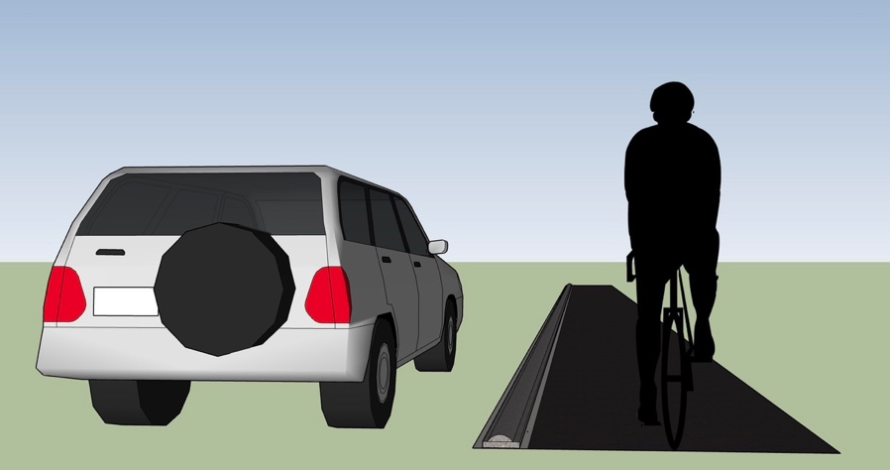
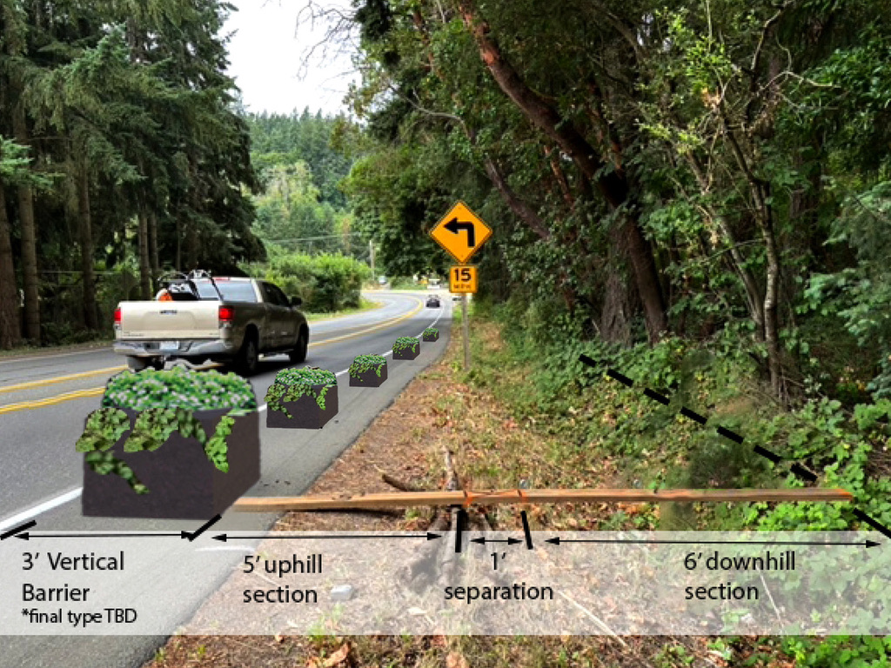
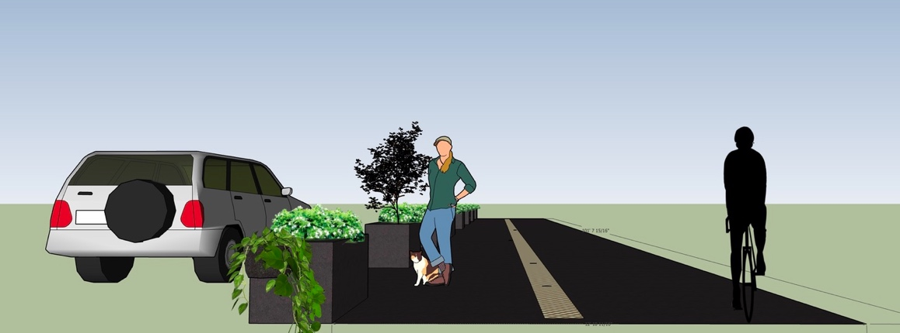
City Council Voted to make 5’ bike lanes instead of a 10’ path for many types of users

Slide 11
Why?
City council mostly only hears from fast bikers and people who need less safety
Some City council members don’t believe very many students will start to bike

Slide 12
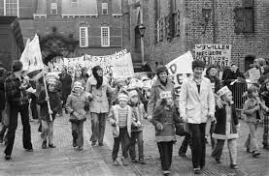
How Did The Netherlands Become the Top Biking Place in the World?
A protest called “Stop the Child Killing” led by parents and children

Slide 13
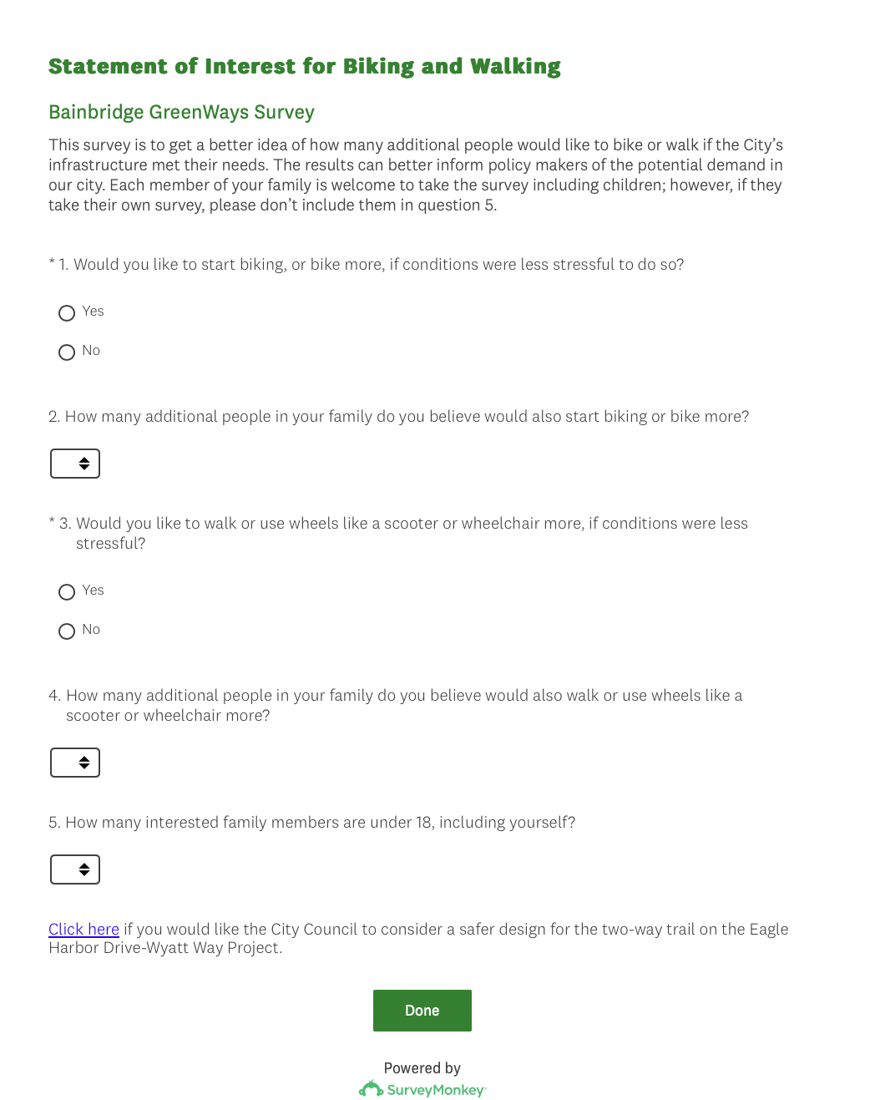
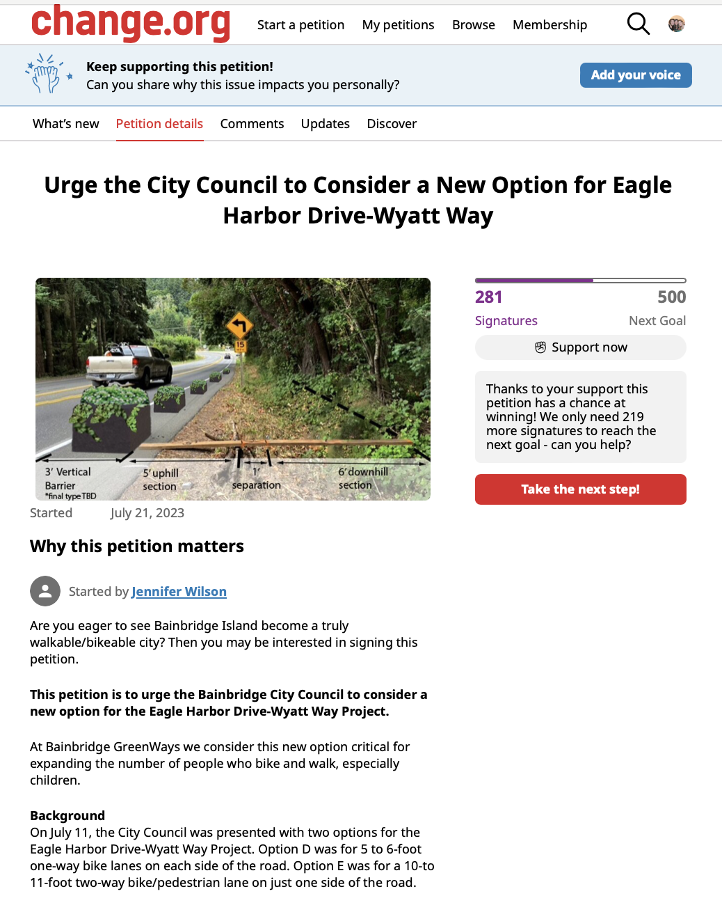
What Can You Do? We Need Your Help to Help Students Bike Safely
Sign our Statement of Interest” to show council you want to bike and walk more
Sign our Petition to make Eagle Harbor/ Wyatt designed for students
Speak at City Council meetings about above
E-mail city council members about above
Ask your family and friends to do the above

Slide 14
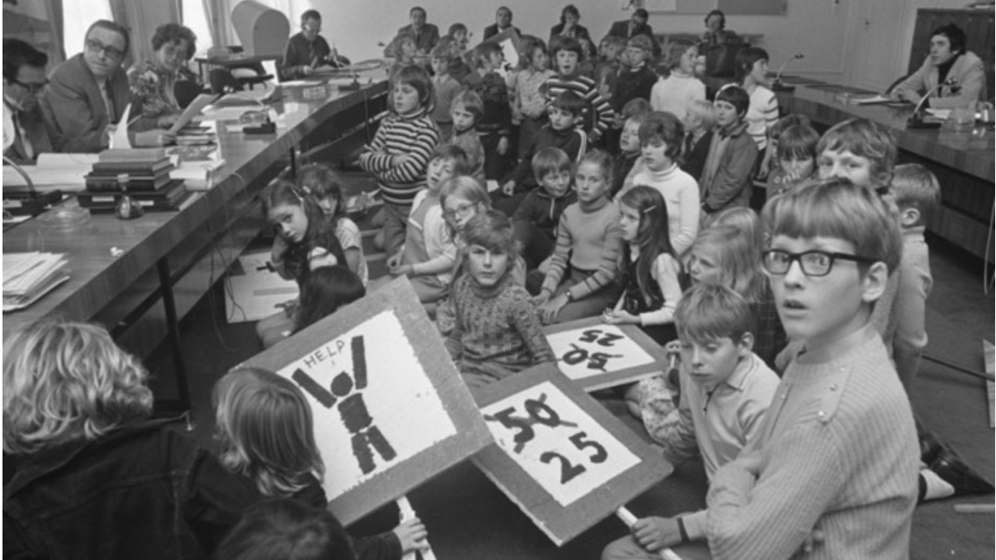
If You Want to Bike More on Bainbridge Island, City Council Needs to Know !
Watch for an important council meeting in November

